Slide 1

SOD’23 Progress Slides
Group 10
Cindy Aprilia
Niurguiana Borisova
Robel Gebrewold
Elmar Karimov

Slide 2
Week 1: Course organization. Essentials of service orientation. Case presentation. Design documentation
<12.09.2023>
Course organization : Done (05/09/2023) Get to know the team members
Essentials of service orientation :
Case presentation : Done (08/09/2023) Background and study context >> Business Canvas (Part 1)
Design documentation :

Slide 3
9.3 billion people worldwide will need to be fed by 2050, therefore ensuring food security poses major challenges.
Reducing food waste, enhancing infrastructure and promoting more efficient production techniques are key ways to improve food security.
https://www.wur.nl/en/show/food-security-11.htm

Slide 4
Target
https://www.theglobaleconomy.com/Ethiopia/Employment_in_agriculture/
https://data.worldbank.org/?locations=ET
https://www.usaid.gov/ethiopia/agriculture-and-food-security

Slide 5
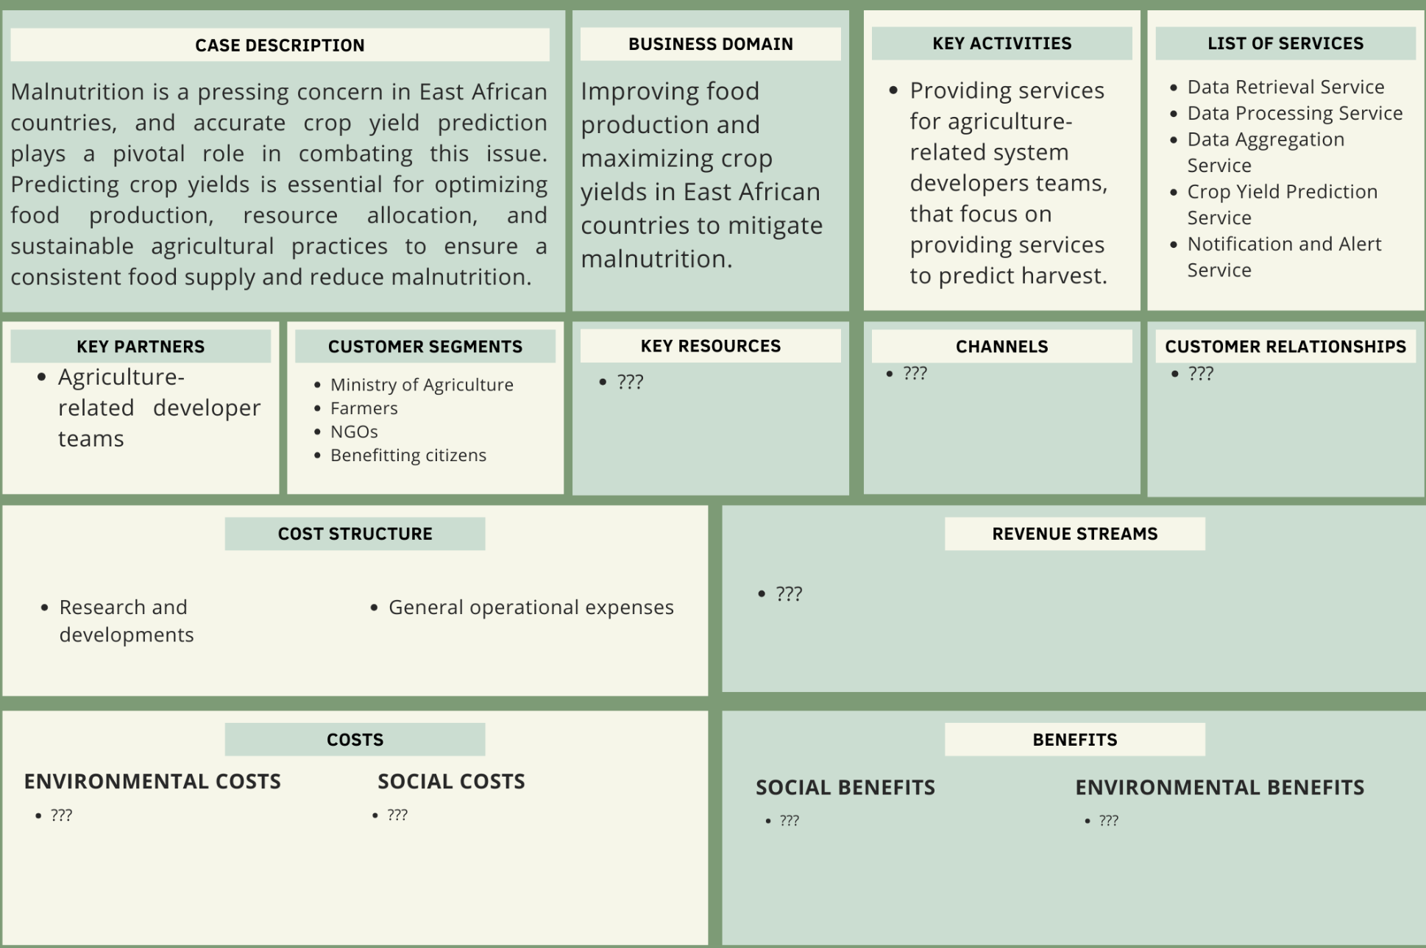
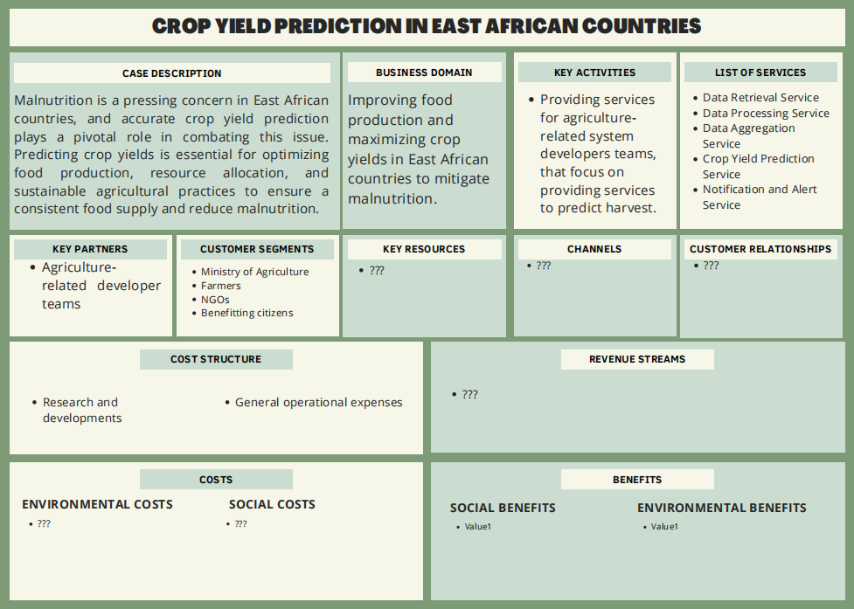
Notes:
List of services : Explain what those services will work on Key partner + Customer segments are both stakeholder. Key partner = The one calling our services Customer = End client
Key resources channels, and customer relationship are about business, will be added in later progress Cost and benefits at the lowest column are sustainability cost and benefit, therefore will be added in later progress too

Slide 6
Notes:
List of services : Explain what those services will work on Key partner + Customer segments are both stakeholder. Key partner = The one calling our services Customer = End client
Key resources channels, and customer relationship are about business, will be added in later progress Cost and benefits at the lowest column are sustainability cost and benefit, therefore will be added in later progress too

Slide 7
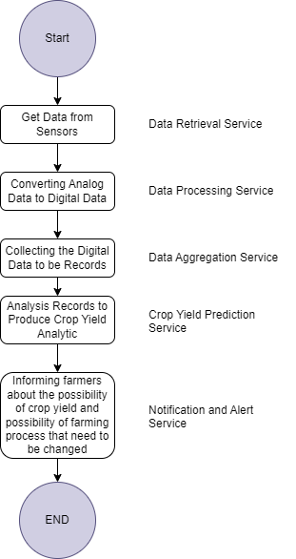
Notes:
List of services : Explain what those services will work on Key partner + Customer segments are both stakeholder. Key partner = The one calling our services Customer = End client
Key resources channels, and customer relationship are about business, will be added in later progress Cost and benefits at the lowest column are sustainability cost and benefit, therefore will be added in later progress too

Slide 8
Week 2: Service identification
<19/09/2023>
Business Services :
Crop Yield Prediction Service
Fair Price Advisor Service
Auditing Investment Service
Recommendation Service
Non-Functional Requirements :
Security : Make sure only authorise companies has access to view live data of plantations
Availability : Service always on when clients are calling
Reliability : The data is up-to-date and correct
Functional Requirement :
The system shall predict the crop yield for a given crop type, planting date, and geographic location, based on historical data and current weather conditions.
The system shall provide users with easy recipes for dishes that can be made with on-season plants.
Foreign investor can get better info about the local plantations prior, and while the investment is running
The system shall provide farmers with information about the monetary value of different plant species, based on current market prices.

Slide 9
Week 2 Revision: Functional Requirements (FR) and Non-Functional Requirements (NFR)
<26/09/2023>
International Agriculture Investment Dataspace Service FR :
Maintain a comprehensive audit trail of all user interactions and data modifications within the system for auditing purposes.
Log and timestamp all access and data changes for accountability.
Maintain up-to-date law and regulations of countries data-sharing
Uniformed model dataspace
Maintain up-to-date MOU of companies and farmers
Recipe Recommendation Service FR:
AI-driven recommendation engine that suggests recipes based on the availability of on-season ingredients, user preferences, and dietary restrictions.
Provide nutritional information for each recipe, including calorie count, macronutrient content, and essential vitamins and minerals.
Fair Price Service FR :
Calculate and provide real-time or periodic market price predictions for various crops based on the ML model's output.
Hence Allowing farmers to specify the crop type and location for personalised price predictions.
Provide historical market price data to help farmers compare current prices with past trends.
Offer insights into price fluctuations over time and factors influencing these changes.
Crop Yield prediction Service FR :
Employ machine learning and historical data to accurately forecast crop yields, empowering farmers and stakeholders with valuable insights for crop planning and management.
Customise recommendations and information based on the geographical location of the farmer, taking into account regional climate and soil variations.
Non-Functional Requirements (NFR) :
Performance | Data Security | Data Accuracy | Transparency | Cultural and Law Compliance
Notes:
Performance(ALL)
Response Time: Define acceptable response times for accessing real-time data and reports.
Data Update Frequency: Specify how often sensor data and GIS information are updated and made available to users.
Scalability: Ensure the service can scale to accommodate growing numbers of sensors and users without significant degradation in performance.
Support and Maintenance (ALL): Regularly assess the service's effectiveness and gather feedback to make continuous improvements and refinements.
Data security (Investment System and Crop Yield Prediction)
The system should collect real-time data from GIS, sensors and user input.
There should be mechanism to ensure all the data are correct
Ensure that authorized users, especially investment companies abroad, can access the data securely from any location.
Encrypt data transmission and storage to protect sensitive information.
Historical Data Accuracy: Ensure that historical price and yield data used for machine learning are accurate and free from bias.
Data Validation: Implement data validation processes to identify and correct erroneous or inconsistent data.
Cultural&Law Complience :
International Data Access : Compliance with international data protection regulations (e.g., GDPR) should be considered when handling data from foreign investors.
Data Ownership and Privacy : Define clear data ownership and privacy policies, specifying how data collected from plantations will be used and shared.
Compliance with Price Regulations: Ensure that the service complies with local and national pricing regulations and standards.
Fair Pricing: Ensure that the pricing model is designed to be fair to farmers, considering their costs and market conditions.
Cultural Sensitivity: Respect and consider cultural preferences and sensitivities in recipe recommendations.
Food Safety: Ensure that the recommended recipes comply with food safety regulations and guidelines.
Copyright Compliance: Respect copyright laws when using and sharing recipe content.
Illegal substances : Make sure there are no recipe made with illegal ingredients according to its location
Availability
Uptime: Establish a minimum uptime percentage (e.g., 99.9%) that the service must maintain.
Failover and Redundancy: Implement failover mechanisms and redundancy to minimize service disruptions.
Disaster Recovery: Have a disaster recovery plan in place to recover data and services in case of unexpected events.
Transparency of Availability: User are aware when the system are not available (CYP, Audit, Fair Price)
Offline Mode : Allow user get the information from cache (Recipe recommendation)
Recommendation Accuracy (Crop Yield Prediction):
Recommendation Precision: The system should provide highly accurate and relevant recommendations to farmers based on factors like climate, soil conditions, historical data, and crop suitability models.
Machine Learning Models: If machine learning is used for recommendations, continuously train and improve the models to enhance accuracy over time.
Explainability: Make the pricing process transparent and explainable to farmers so that they understand how prices are determined.

Slide 10
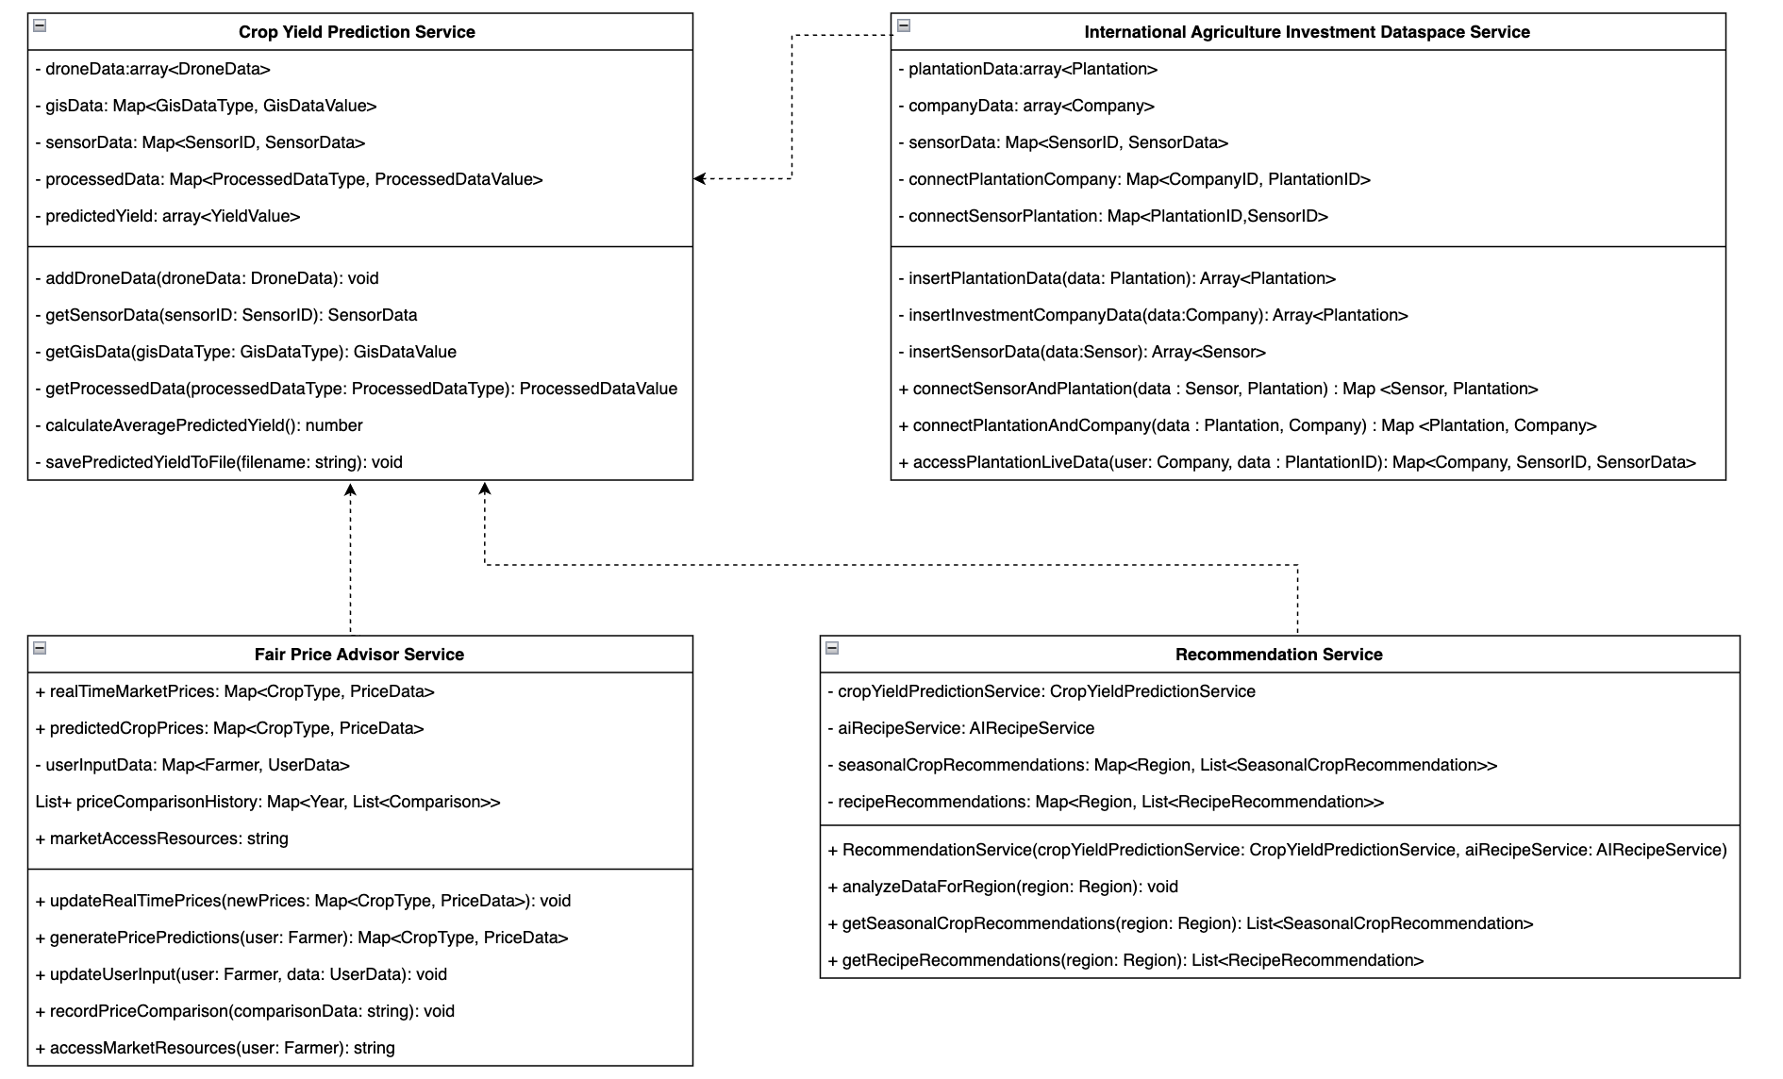
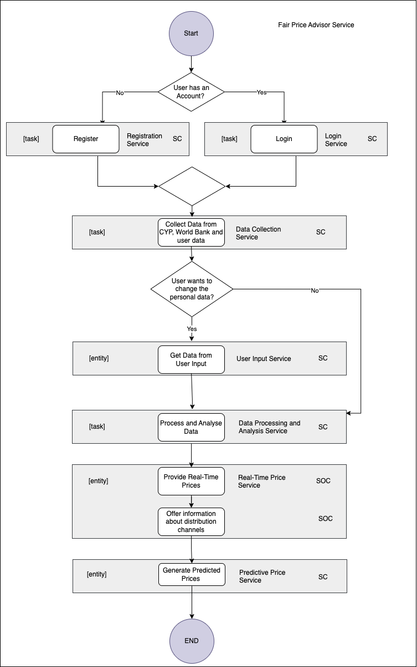
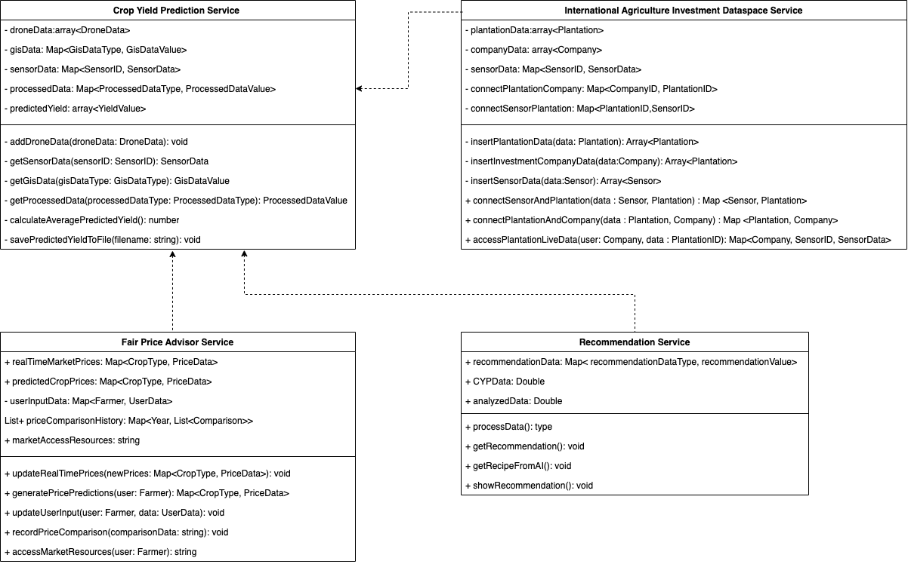
Week 3: Class and Activity diagrams
<26.09.23>

Slide 11
Week 4: Capturing design rationale
<date>
<your progress and tasks>
…

Slide 12
Week 5: Design for quality. Design for sustainability
<date>
<your progress and tasks>
…

Slide 13
Week 6: Service Oriented Design with UML
<date>
<your progress and tasks>
…

Slide 14
Week 7: The energy challenge for the cloud software industry. Service Oriented Design with Views
<date>
<your progress and tasks>
…

